Slide 1

Facility List

Slide 2
Thank you for your interest in Loudon Industries, Inc.
We offer a diverse range of machining and engineering capabilities to satisfy our customers’ diverse requirements. CNC Gear cutting of all types produced from all grades of bar stock, forgings, and castings is one of our areas of expertise. We are a complete shop offering services from purchasing the selected raw material to supplying a finished product ready for use.
Our capabilities include precision CNC and Manual machining, EDM work, grinding, turning, milling, welding, drilling, broaching, project design/engineering, Zeiss CMM services, and assemblies. We maintain a complete quality control department and quality assurance system. A quality control manual is available upon request.
Loudon Industries utilizes an NT based local area network to provide CAD/CAM capabilities to our design and engineering department, as well as supplying current information directly to our shop floor via touch screen computers. Our local area network is also the base for our new administrative/plant management software.
Enclosed is a listing of some of the products and services currently in production. In addition, we have enclosed sample photos of our equipment, shop, and various products currently in process. The listing and photos are representative but not inclusive.
We welcome requests for quotations on products that you may require. Please see the last page for complete contact information.
Thank you again for considering Loudon Industries. Please review the following pages for a brief overview of our facility and equipment.

Slide 3
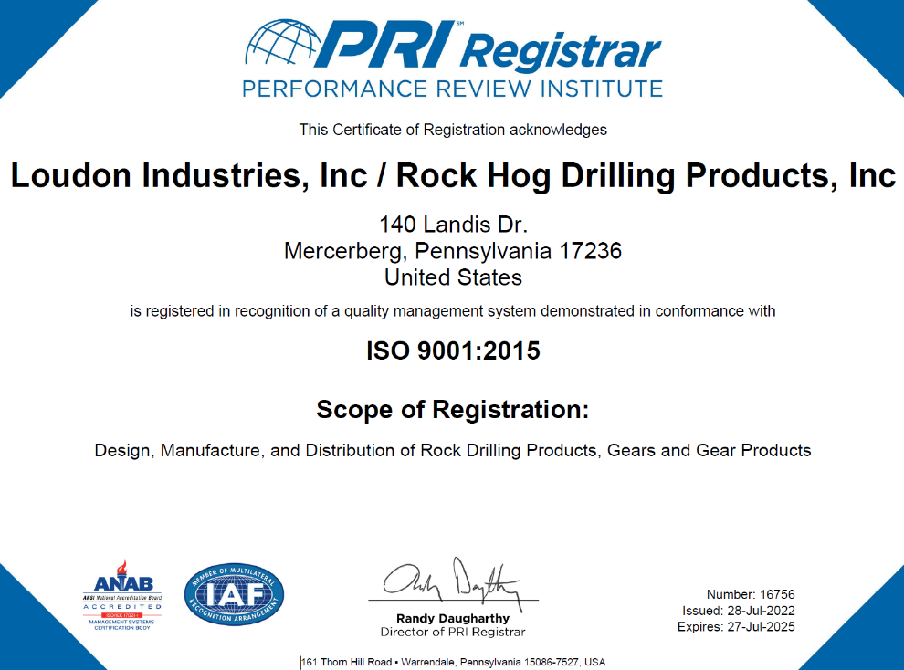
ISO 9001 Certified

Slide 4
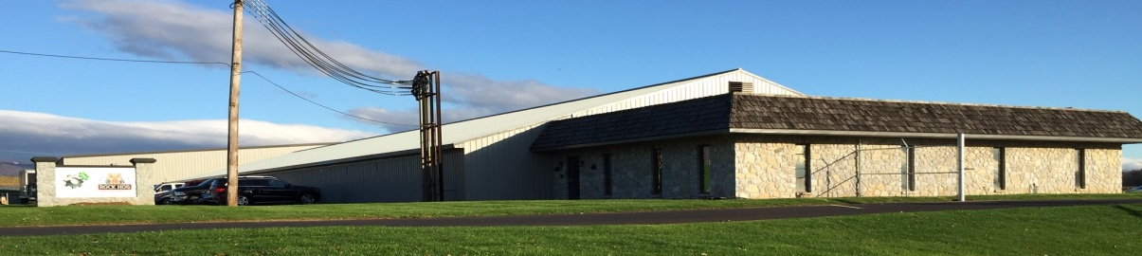
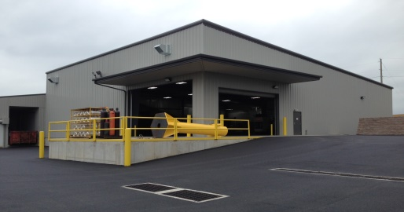
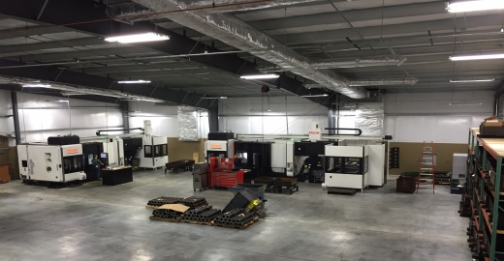
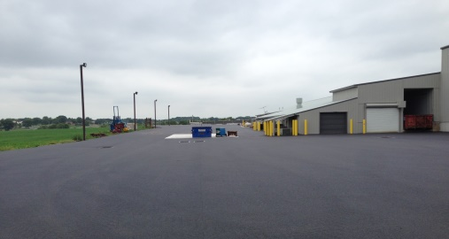
Our 45,000 square foot facility is located in south central Pennsylvania. The facility is easily accessible by our customers, suppliers, and employees. We are located just off Route 16, between Interstate 81 and the Pennsylvania Turnpike, in the borough of Mercersburg.
Our entire facility is temperature controlled. Our shipping and receiving area accommodates both dock and tailgate loading and unloading.
We welcome all our customers to visit our facility.

Slide 5

Equipment Overview

Slide 6
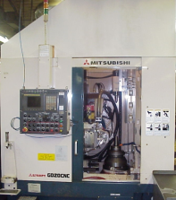
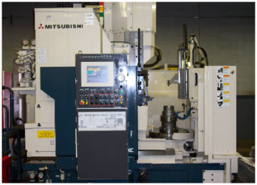
Equipment Overview
Gear Cutting
Mitsubishi GD20 CNC Hob
Mitsubishi ST40 CNC Shaper

Slide 7
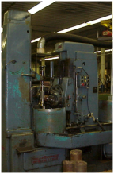
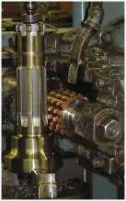
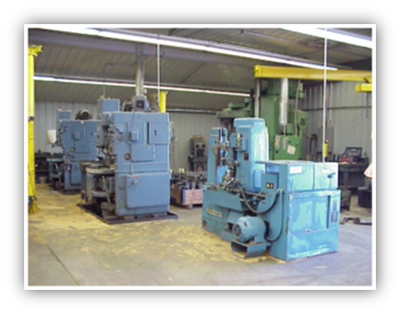
Equipment Overview
Gear Cutting
G & E Gear Hobbes
Fellows #36 Gear Shapers &
G & E Gear Hob

Slide 8
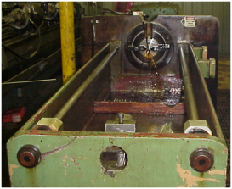
Equipment Overview
Gear Cutting
Colonial Helical Spline Broach

Slide 9
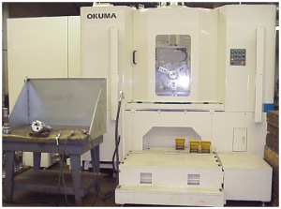
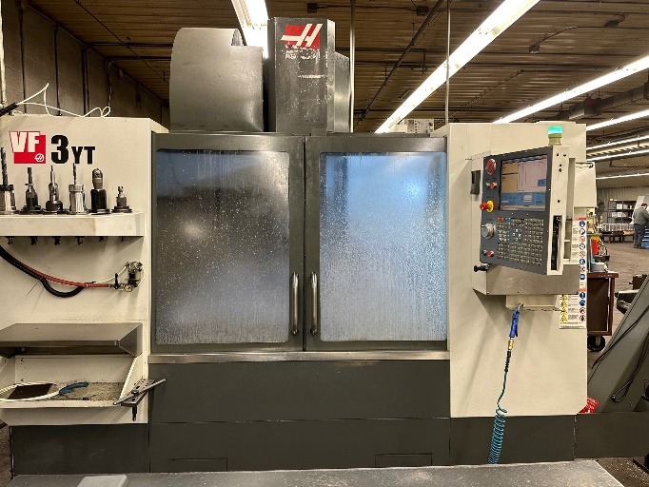
Equipment Overview
Milling
Okuma MX-60 Horizontal Machining Center
Haas VF3YT Vertical Machining Center
(with 2 Rotary tables)
(with Rotary table)

Slide 10
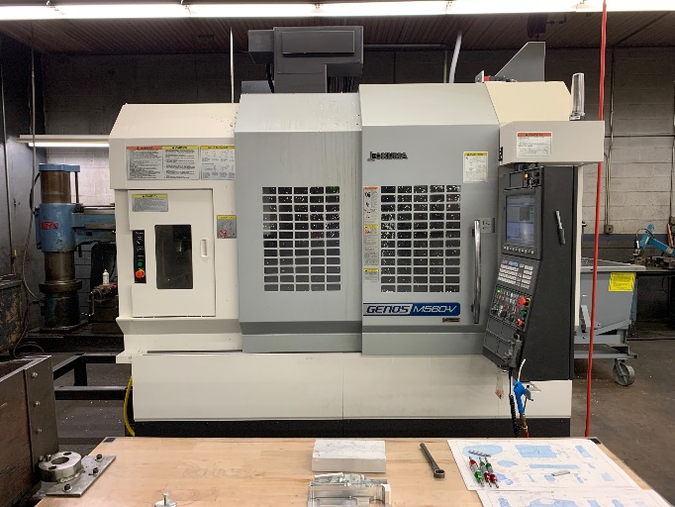
Equipment Overview
Milling
Okuma Genos M560-V
(with Rotary table)

Slide 11
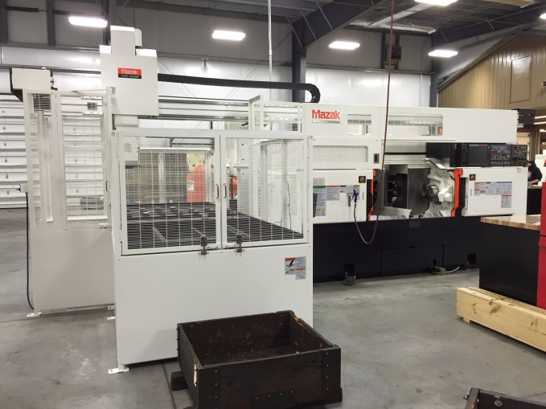
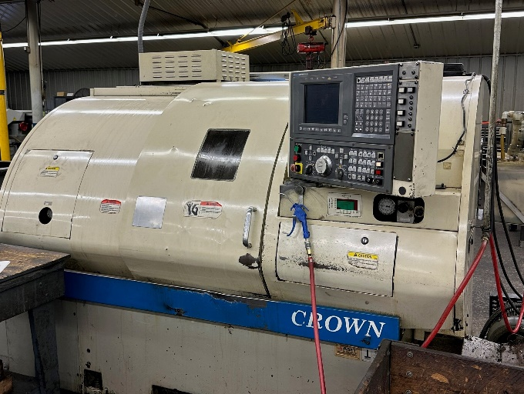
Equipment Overview
Turning
Mazak Multiplex 6300Y
Okuma Crown Lathe
(with Robotic Loader & 12” Chucks)
(with 10” Chuck)

Slide 12
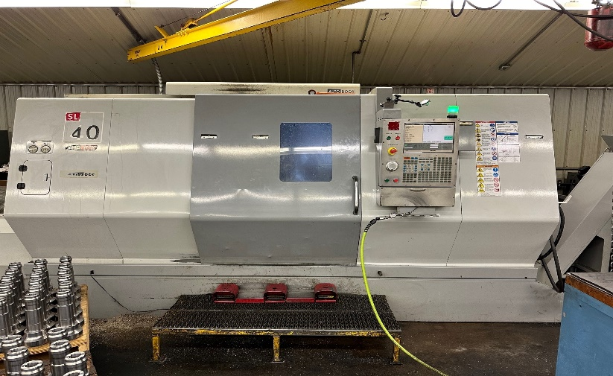
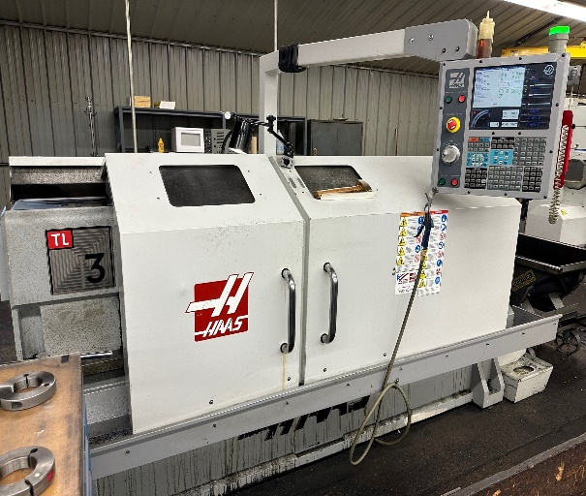
Equipment Overview
Turning
Haas SL-40 Lathe
Haas TL-3 Lathe
(with 16” chuck)
(with 12” chuck)

Slide 13
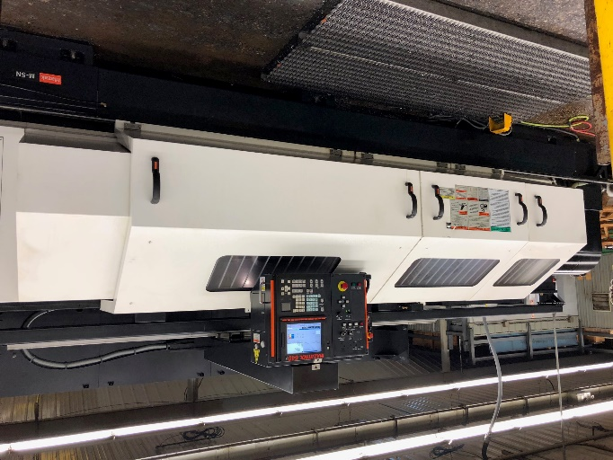
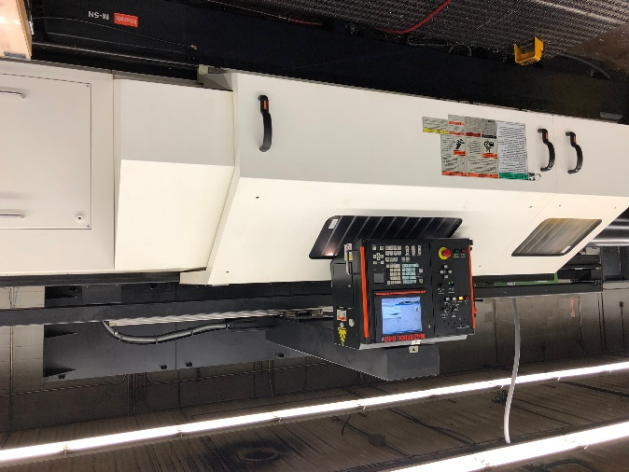
Equipment Overview
Turning
Mazak M5 Lathe
Mazak M5 Lathe
(with 20” quick change chuck & 120” centers)
(with 20” quick change chuck & 80” centers)

Slide 14
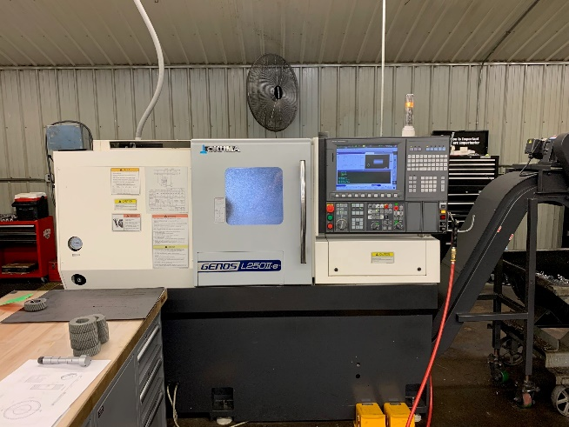
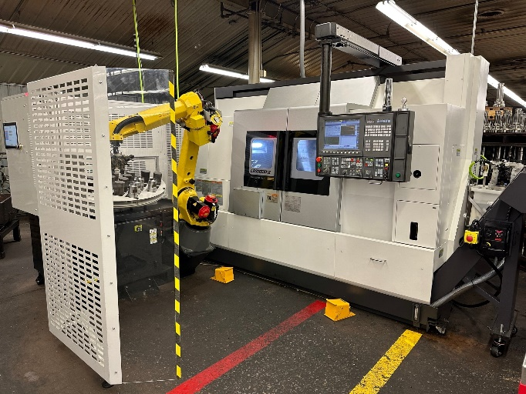
Equipment Overview
Turning
Okuma Genos L250II-E
Okuma LB3000EX-II/800-MYW
(with 8” chuck)
(with Fanuc AWR automation)

Slide 15
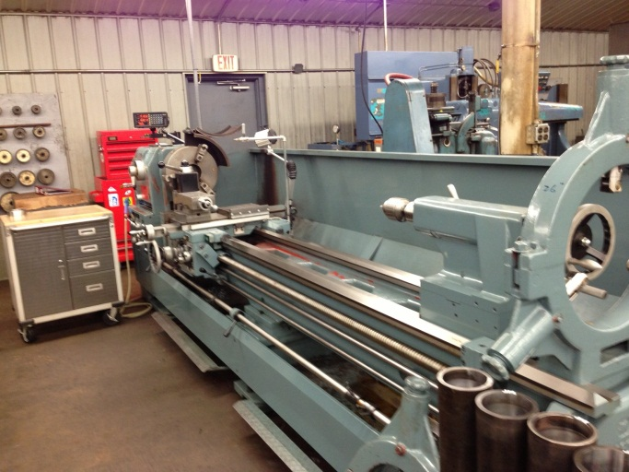
Equipment Overview
Turning
Kingston HD-26 Lathe w/ digital readout
(swing over bed 26”, distance between
Centers 120”, spindle bore 4 1/16”)

Slide 16
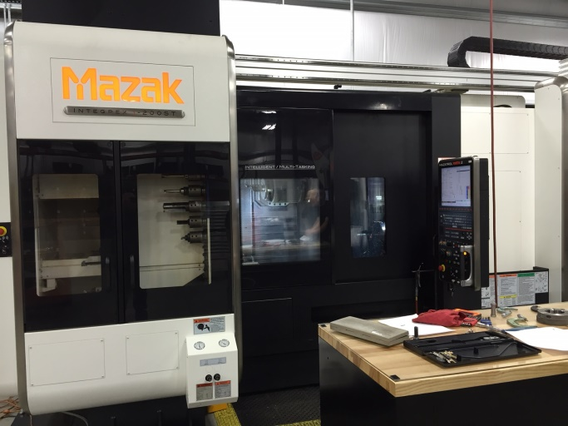
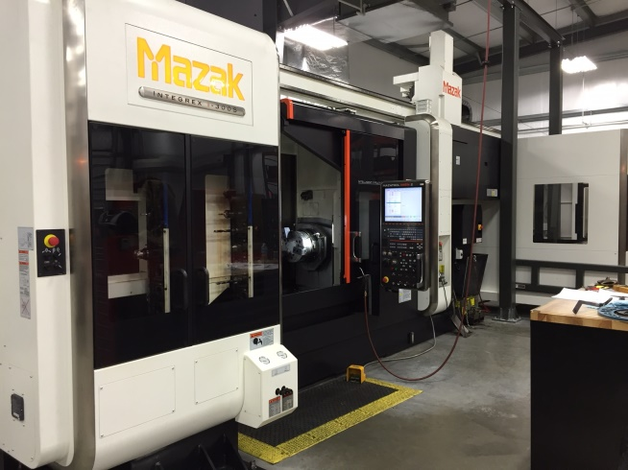
Equipment Overview
Milling & Turning
Mazak Integrex I-200ST
Mazak Integrex I-300S
(with gantry robot & Renishaw probing)
(with gantry robot & Renishaw probing)

Slide 17
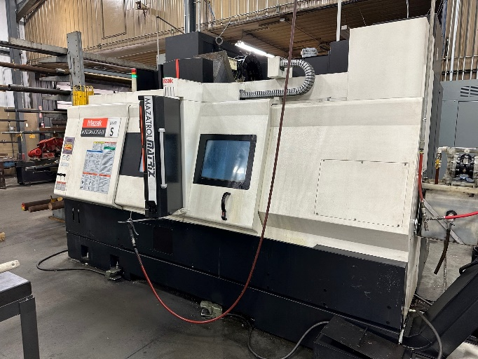
Equipment Overview
Milling & Turning
Mazak Integrex 200-IV
(with 10” chucks)

Slide 18
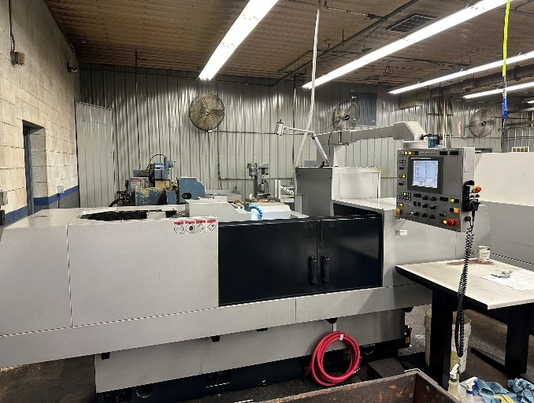
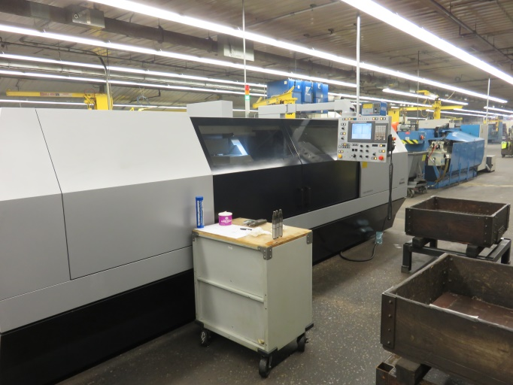
Equipment Overview
OD Grinding
Okomoto Precision CNC Cylindrical Grinder
Okomoto Precision CNC Cylindrical Grinder
(12” Diameter x 20” Centers Capacity )
(12” Diameter x 60” Centers Capacity
w/ Marposs In-Process Gauging System.)

Slide 19
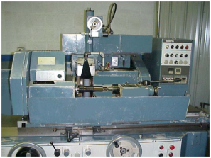
Equipment Overview
OD Grinding
Okomoto Universal Grinder
(12” swing x 36” centers)

Slide 20
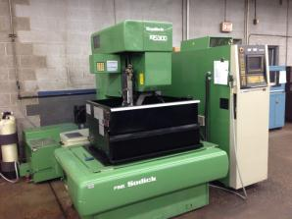
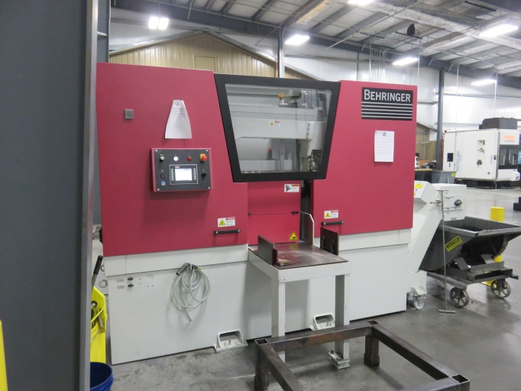
Equipment Overview
Other Machinery
Sodick Wire EDM Machine
Behringer Horizontal Band Saw
(Up to 16” diameter capacity)

Slide 21
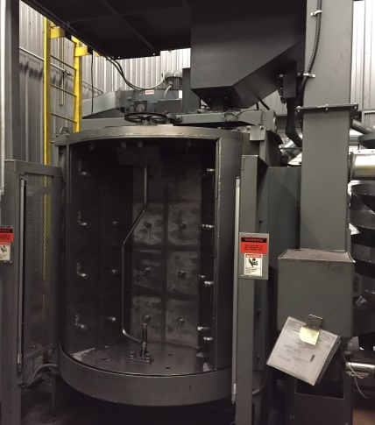
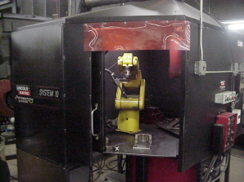
Equipment Overview
Other Machinery
Pangborn Shot Peener
Lincoln Electric Automated Welder
(with Fanuc robot & automatic positioner)

Slide 22
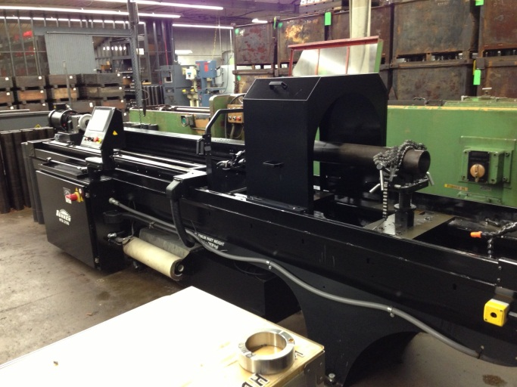
Equipment Overview
Other Machinery
Sunnen HTA 2100 Tube Honing Machine
(can bore 2 ½” – 21” dia. and stroke
Up to 78 ¾” long)

Slide 23
Machinery Constraints
Machine Type | Max Diameter | Max Length | Max Gear Class
Lathes Turning | 24” | 120” | -
Machining Centers Milling | 24” | 40” | -
OD Grinding | 12” | 60” | -
Multi-Task Machining Turning & Milling | 26” | 60” | -
Gear Cutting Hobbing | 24” | 16” | 12
Gear Cutting Shaping | 36” | 10” | 12
Gear Cutting Broaching | 24” | 72” | 8

Slide 24
Quality Control

Slide 25
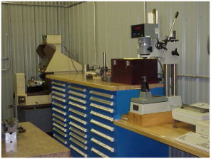
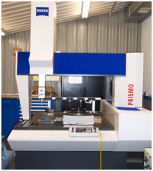
Equipment Overview
Quality Control
Surface Hardness Tester, Gauges, Optical Comparator
Zeiss Coordinate Measuring Machine
(with the ability to check gear data
and multi point scanning ability)

Slide 26

Contact Information
Phone Number: 717-328-9808
Fax Number: 717-328-5010
Mailing/ Shipping Address:
Loudon Industries, Inc.
140 Landis Drive
Mercersburg, PA 17236
Business Hours: Monday – Friday 8:00 AM – 4:30 PM
Website: www.loudonindustries.com
Email: sales@liiusa.com

